Slide 1
ELECTRICAL SCIENCE-1
(15B11EC111)
Unit-7
Electrical Instruments
( Essentials of an Instrument, Permanent Magnet Moving Coil (PMMC) Instruments, voltmeter, ammeter, Ohmmeter, Meter Sensitivity (Ohms Per-Volt Rating); Loading Effect; Multimeter; Cathode Ray Oscilloscope: Construction, Working and Applications. Function Generators )
Lecture-3
Dr. Abhishek Kashyap
Assistant Professor (Senior Grade, JIIT Noida)

Slide 2
Topics to be covered
AMMETERS AND VOLTMETERS
PERMANENT-MAGNET MOVING COIL (PMMC) INSTRUMENTS
PROBLEMS
PRACTICE PROBLEMS
REFERENCES

Slide 3
Ammeters and Voltmeters
The basic principle of the ammeter and of the voltmeter is the same.
Both are current operated devices i.e. deflecting torque is produced when current flows through their operating coils.
In the ammeter, the deflecting torque is produced by the current we wish to measure, or a certain fraction of that current.
In the voltmeter, the deflecting torque is produced by a current which is proportional to the potential difference we wish to measure.
Thus, the same instrument can be used as an ammeter or voltmeter with proper design.

Slide 4
Permanent-Magnet Moving Coil (PMMC) Instruments
(Ammeters and Voltmeters)
These instruments are used either as ammeters or voltmeters and are suitable for d.c. work only.
This type of instrument is based on the principle that when a current carrying conductor is placed in a magnetic field, mechanical force acts on the conductor.
The coil placed in the magnetic field and carrying the operating current is attached to the moving system.
With the movement of the coil, the pointer moves over the scale to indicate the electrical quantity being measured. This type of movement is known as $D’Arsonval movement.
$After the French physicist Arsene D’Arsonval who first conceived such a movement of the instrument

Slide 5
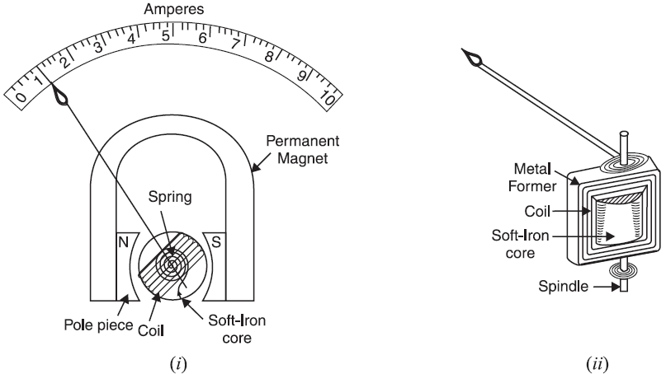
Permanent-Magnet Moving Coil (PMMC) Instruments
Construction:
Fig. shows the various parts of a permanent-magnet moving coil instrument.

Slide 6
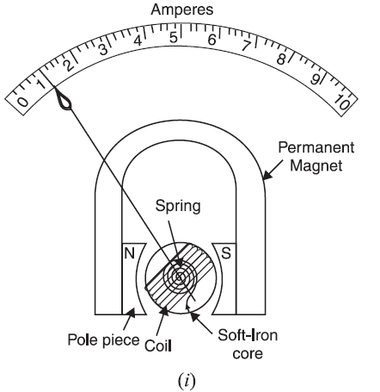
Permanent-Magnet Moving Coil (PMMC) Instruments
Construction:
It consists of a light rectangular coil of many turns of fine wire wound on an aluminium former inside which is an iron core as shown in Fig. (i).
The coil is delicately pivoted upon jewel bearings and is mounted between the poles of a permanent horse-shoe magnet.
Attached to these poles are two soft-iron pole pieces which concentrate the magnetic field.

Slide 7
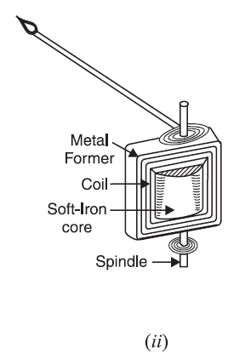
Permanent-Magnet Moving Coil (PMMC) Instruments
Construction:
The current is led into and out of the coil by means of two control hair-springs, one above and the other below the coil, as shown in Fig. (ii).
These springs also provide the controlling torque.
The damping torque is provided by eddy currents induced in the aluminium former as the coil moves from one position to another.

Slide 8
Permanent-Magnet Moving Coil (PMMC) Instruments
Working:
When the instrument is connected in the circuit to measure current or voltage, the operating current flows through the coil. Since the coil is carrying current and is placed in the magnetic field of the permanent magnet, a mechanical torque acts on it.
As a result, the pointer attached to the moving system moves in a clockwise direction over the graduated scale to indicate the value of current or voltage being measured.

Slide 9
Permanent-Magnet Moving Coil (PMMC) Instruments
Working:
If the current in the coil is reversed, the deflecting torque will also be reversed since the direction of the field of the permanent magnet is the same.
Consequently, the pointer will try to deflect below zero. Deflection in this direction (i.e. reverse direction) is prevented by a spring “stop”.
Since the deflecting torque reverses with the reversal of current in the coil, such instruments can be used to measure direct currents and voltages only.

Slide 10
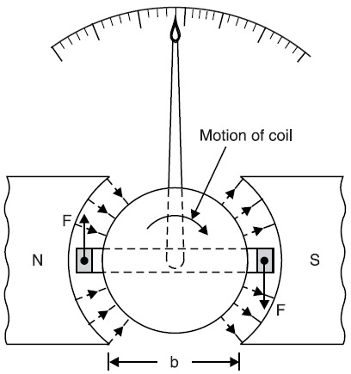
Permanent-Magnet Moving Coil (PMMC) Instruments
Deflecting torque:
The magnetic field in the air gap is radial due to the presence of soft-iron core.
This means that conductors of the coil will always move at right angles to the field.
When current is passed through the coil, forces act on its both sides which produce the deflecting torque.
Referring to Fig., let,
B = flux density in Wb/m²
l = length or depth of coil in m
b = breadth of coil in m
N = No. of turns in the coil

Slide 11
Permanent-Magnet Moving Coil (PMMC) Instruments
Deflecting torque:
If a current of I amperes flows in the coil, then force acting on each coil side is given by ;
Force on each coil side, F = B I l N newtons
Deflecting torque, T_{d} = Force × perpendicular distance
= (B I l N) × b
∴ T_{d} = B I N A newton-metre
where A (= b × l) is the area of the coil in m².

Slide 12
Permanent-Magnet Moving Coil (PMMC) Instruments
Deflecting torque:
Since the values of B, N and A are fixed,
∴ T_{d} ∝ I
The instrument is spring-controlled so that T_{C} ∝ θ
The pointer will come to rest at a position where T_{d} = T_{C}
∴ θ ∝ I
Thus, the deflection is directly proportional to the operating current.

Slide 13
Permanent-Magnet Moving Coil (PMMC) Instruments
Advantages
Uniform scale i.e., evenly divided scale.
Very effective eddy current damping because the aluminium former moves in an intense magnetic field of the permanent magnet.
High efficiency as it requires very little power for its operation.
No hysteresis loss as the magnetic flux is practically constant.
External stray fields have little effect on the readings as the operating magnetic field is very strong.
Very accurate and reliable.

Slide 14
Permanent-Magnet Moving Coil (PMMC) Instruments
Disadvantages
Such instruments cannot be used for a.c. measurements.
About 50% more expensive than moving-iron instruments because of their accurate design.
Some errors are caused due to variations (with time or temperature) either in the strength of permanent magnet or in the control springs.

Slide 15
Permanent-Magnet Moving Coil (PMMC) Instruments
Applications:
Permanent-magnet moving coil instruments are acknowledged to be the best type for all d.c. measurements. They are very sensitive and maintain a high degree of accuracy over long periods.
The chief applications of such instruments are :
In the measurement of direct currents and voltages.
In d.c. galvanometers to detect small currents.
In ballistic galvanometers used mainly for measuring changes of magnetic flux linkages.

Slide 16
Example
The resistance of a moving coil voltmeter is 12,000 Ω. The moving coil has 100 turns and is 4 cm long and 3 cm wide. The flux density in the air gap is 6 × 10^{–2} Wb/m². Find the deflection produced by 300 V if the spring control gives a deflection of one degree for a torque of 25 × 10^{–7} Nm.

Slide 17
Solution
Applied voltage, V = 300 volts
Resistance of voltmeter, R_{V} = 12,000 Ω
∴ Current through coil, I = V / R_{V} = 300 / 12,000 = 0.025 A
Area of coil, A = 0.04 × 0.03 = 12 × 10^{–4} m²
Deflecting torque, T_{d} = BINA Nm
Here, B = 6 × 10^{–2} Wb/m² ;
I = 0.025 A ;
N = 100 turns ;
A = 12 × 10^{–4} m²
T_{d} = 6 × 10^{–2} × 0.025 × 100 × 12 × 10^{–4} = 18 × 10^{–5} Nm

Slide 18
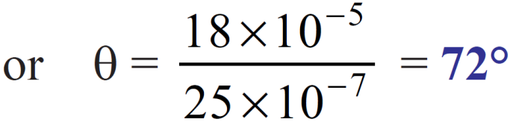
Solution
If θ is the deflection, then controlling torque T_{C} is
T_{C} = k θ = 25 × 10^{–7} θ Nm
In the final deflected position, T_{C} = T_{d}
25 × 10^{–7} θ = 18 × 10^{–5}

Slide 19
References
Charles K. Alexander (Author), Matthew N.O Sadiku, “ Fundamentals of Electric Circuits”, 6th ed, Tata Mc Graw Hill, 2019..
D.C. Kulshreshtha, Basic Electrical Engineering, Revised 1st ed, Tata Mc Graw Hill, 2017.
V. K.Mehta, Rohit Mehta, Basic Electrical Engineering, 6th ed, S. Chand Publishing, 2012.

